Slide 1
Torque (pronounced just like ‘talk’)

Slide 2
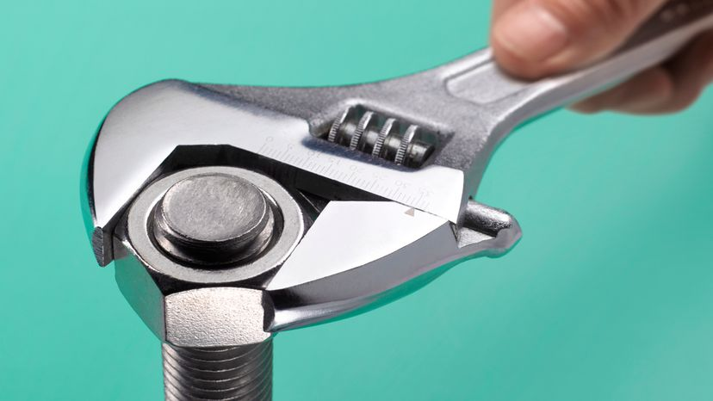
Torque
Torque is a force that causes an object to rotate – more simply, it is a turning or twisting force.
Its symbol is the Greek letter tau (τ), and it is measured in newton‑metres (N m or N·m)
It is also known as the moment of a force.
Unlike linear force, torque does not produce translational motion (Δx, Δy, or Δz, mathematically speaking), but rather rotational motion (Δθ).
Note: torque is a vector, but determining its direction is beyond the scope of this course. You may, however, be required to determine the direction of rotation (CW or CCW) caused by one or more torques acting on an object.
Notes:
3: door, table tennis examples
Torque is technically a pseudovector, which is even further beyond the scope of this course

Slide 3

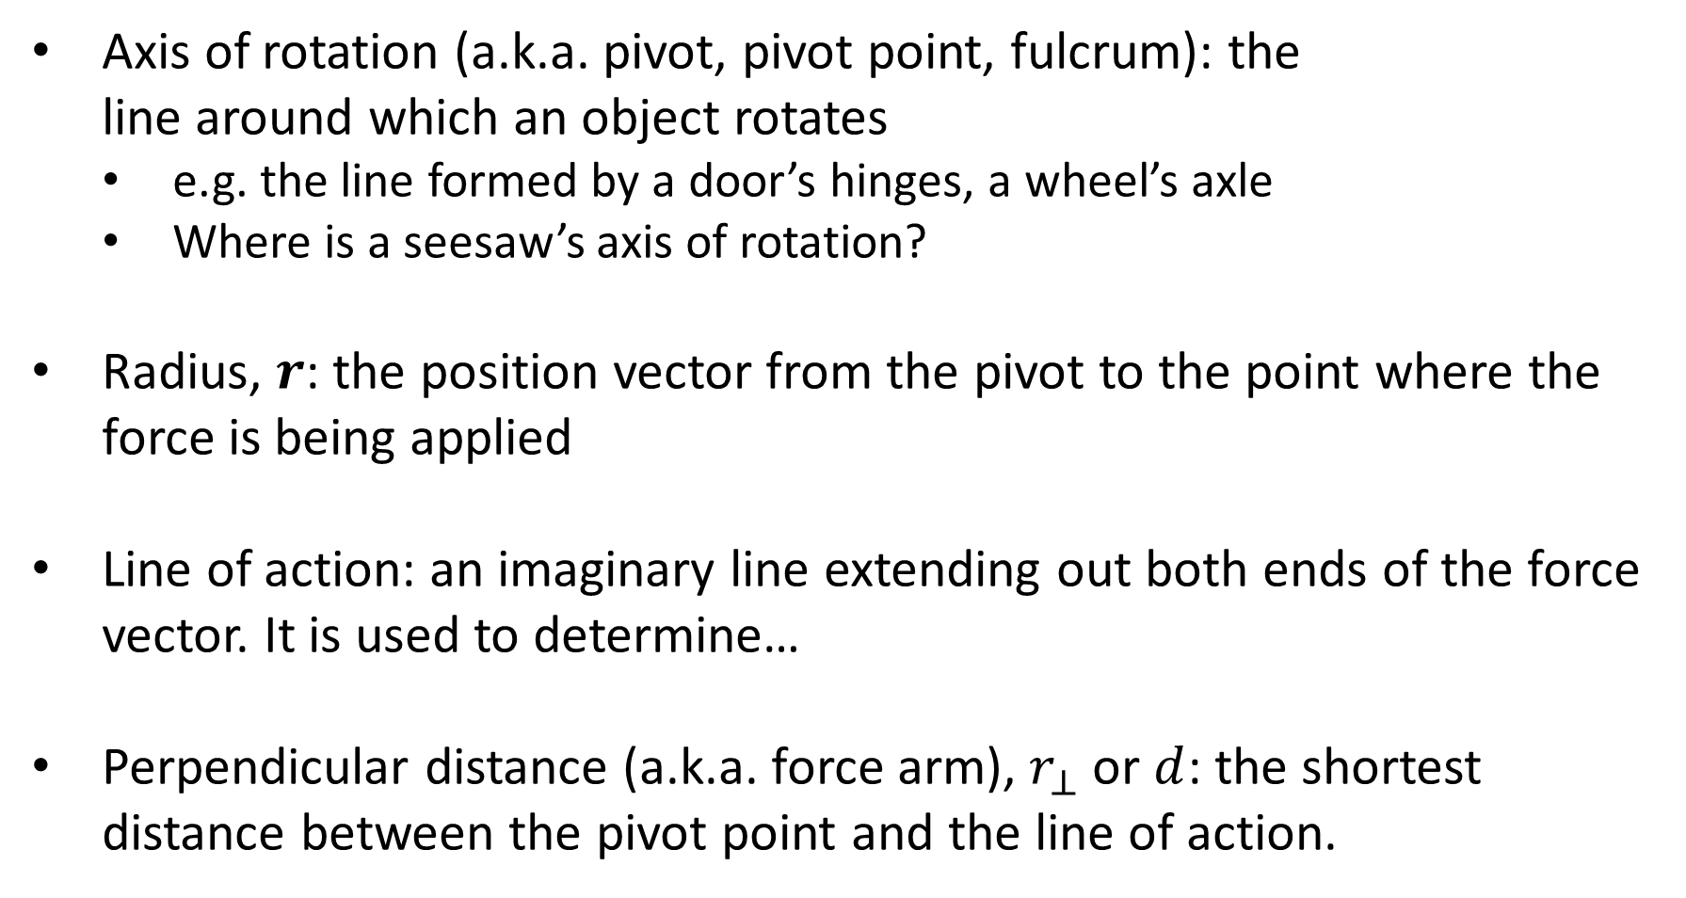
Torque Terminology
Axis of rotation (a.k.a. pivot, pivot point, fulcrum): the line around which an object rotates
e.g. the line formed by a door’s hinges, a wheel’s axle
Where is a seesaw’s axis of rotation?
Radius, $r$: the position vector from the pivot to the point where the force is being applied
Line of action: an imaginary line extending out both ends of the force vector. It is used to determine…
Perpendicular distance (a.k.a. force arm), $r_{⊥}$ or $d$: the shortest distance between the pivot point and the line of action.
Notes:
Pearson uses ‘force arm’

Slide 4
Torque Terminology
Lever arm / moment arm: different sources disagree on what this means.
Your formula sheet and some textbooks see it as roughly equivalent to r, as if it’s the actual physical ‘arm’ of a lever. This is the definition we’ll be using and the one you should learn, even though…
Most other sources use the term interchangeably with (or instead of) perpendicular distance. Watch out for this if you’re using diagrams or other resources from the internet.
Notes:
Many highly reputable sources (e.g. Serway, Tipler, HyperPhysics, Merriam-Webster) define lever arm as perpendicular distance. Only a handful of other sources (formula sheet, STAWA, Heinemann) define it as per point 1. Pearson sidesteps the whole issue by never using the term.

Slide 5
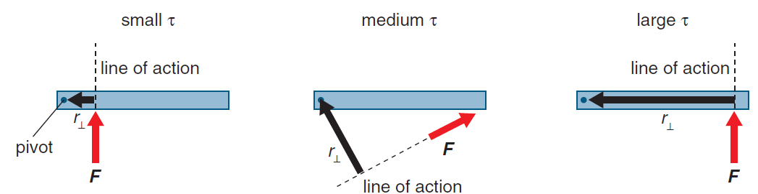
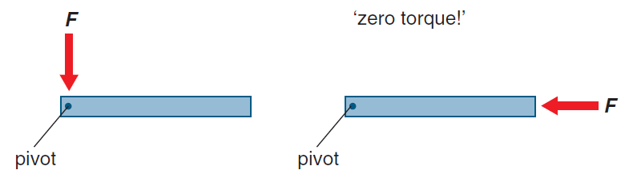
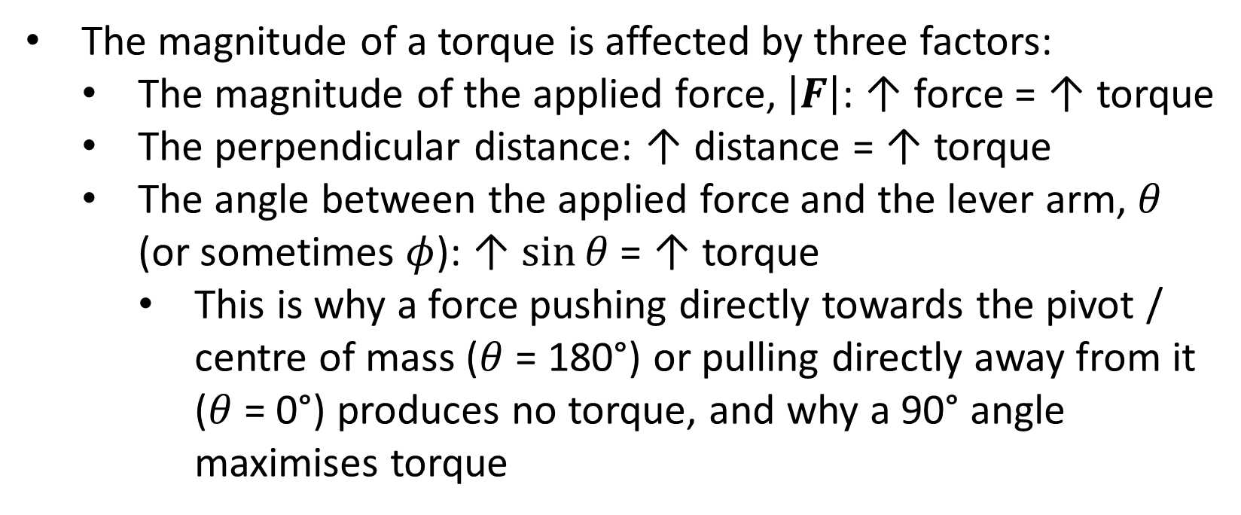
Determining Torque
The magnitude of a torque is affected by three factors:
The magnitude of the applied force, $\left|F\right|$: ↑ force = ↑ torque
The perpendicular distance: ↑ distance = ↑ torque
The angle between the applied force and the lever arm, $θ$ (or sometimes $φ$): ↑ $\sin{θ}$ = ↑ torque
This is why a force pushing directly towards the pivot / centre of mass ($θ$ = 180°) or pulling directly away from it ($θ$ = 0°) produces no torque, and why a 90° angle maximises torque

Slide 6

Determining Torque
Mathematically:
$$τ=rF\sin{θ}=rF_{⊥}=r_{⊥}F$$

Slide 7
Example #1
A woman whose car has a flat tyre has two wheel-nut spanners in the boot of her car. One wheel spanner is 15.0 cm long and the other is 75.0 cm long.
In order to undo the wheel nuts with a minimum amount of effort, which wheel spanner should the woman select?
If the maximum force that the woman can apply is 45.0 N, determine the maximum torque that can be delivered to a wheel nut.

Slide 8
Example #2
A force of 810 N directly up is applied to the handles of a wheelbarrow. The handles are 1.6 m long and make an angle of 25 degrees with the ground.
Calculate the torque.
What is the maximum torque that can be achieved by using this force?

Slide 9
Example #3
A crane is being used to lift a skip of concrete with a total mass of 3.50 tonnes. The lever arm of the crane is 25.0 m long and makes an angle of 37.0° with the vertical. Ignore the mass of the cable when answering these questions.
What is the total weight of the skip?
The skip is lifted so that it is near the top of the crane. How does the torque created by the skip about the pivot change as the skip is lifted to this height?
Calculate the magnitude of the torque about the pivot that the skip exerts on the crane when the skip is at the highest point.

